Slide 1
5 Efficient Ways to Reduce Cybersecurity Risk Today
Dolly J. Krishnaswamy
Lead Compliance Analyst, SecurityScorecard

Slide 2
Agenda
What Cyber Risk Looks Like Today
The 7 Ways to Reduce Vendor Cybersecurity Risk Today

Slide 3
The Cyber-Risk Landscape Today
The cost of data breach continues to escalate.
Attacks get increasingly sophisticated.
Increasingly stringent and far-reaching regulations like GDPR are added to the mix.
Notes:
Cost of breach: The staggering cost of data breaches continues to escalate and is predicted to exceed $2 trillion by next year, according to Juniper Research. The average cost of a single breach is more than $4 million, estimates the Ponemon Institute.
Two third stat from here: https://explore.securityscorecard.com/third-party-breaches-white-paper

Slide 4
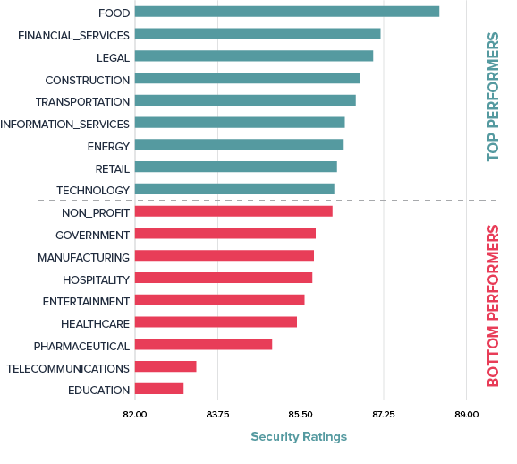
A recent snapshot (Jan 2018) of how 18 major U.S. industries measure up in terms of cybersecurity performance
Attacks Are Rampant Across All Industries

Slide 5
In 2016, the financial services sector was attacked 65 times more often than any other sector.* Our 2017 Financial Report showed that this sector is still a target for hackers: 45% of the financial firms that were scanned had at least one malware event between March and August 2017.
Financial Services: Examples of Weak Security
*according to the IBM Security Trends in the Financial Services Sector Report.

Slide 6
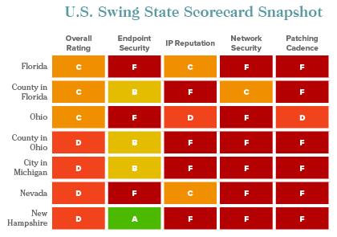
Government Sector: More Examples of Weak Security

Slide 7
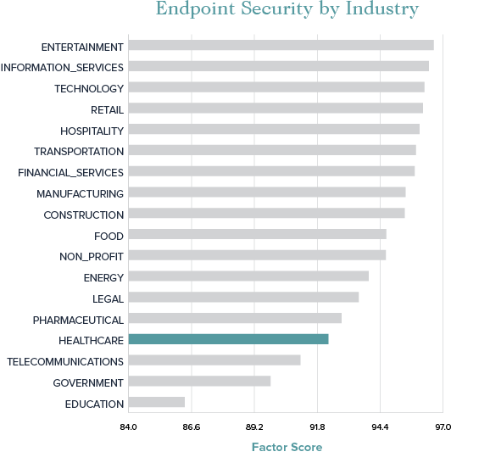
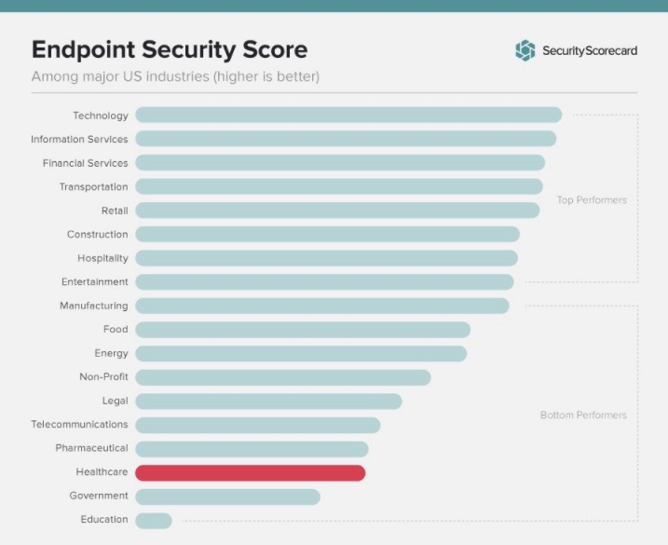
Healthcare Industry: Weak Endpoint Security
Healthcare industry continues to struggle with endpoint security.
Notes:
Securing endpoints can be a major challenge for healthcare organizations.
Healthcare organizations typically have thousands of endpoints while, due to a lack of resources, they struggle to properly monitor and maintain their endpoints.
The growth in IoT devices, smartphones, and tablets can add to this problem and make it very difficult for centralized IT departments to properly secure devices on their networks.
To compound the problem, these devices often store patient data and are the gateway to databases and other systems that contain ePHI.

Slide 8
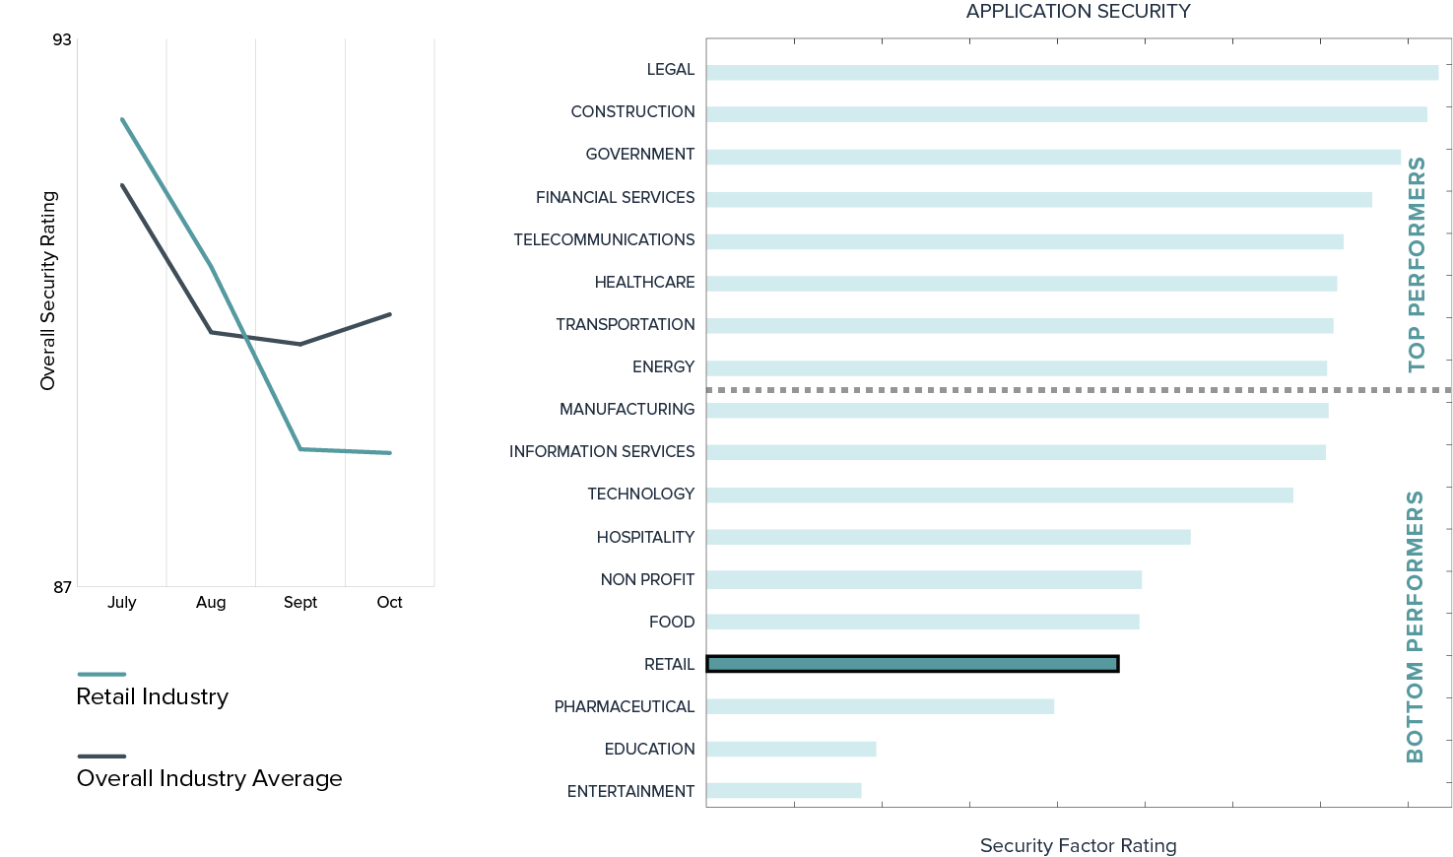
While application security is a tough area of cybersecurity risk to control for all industries, the retail sector in particular has had difficulty battling this issue.
Retail Industry: Weak Application Security

Slide 9
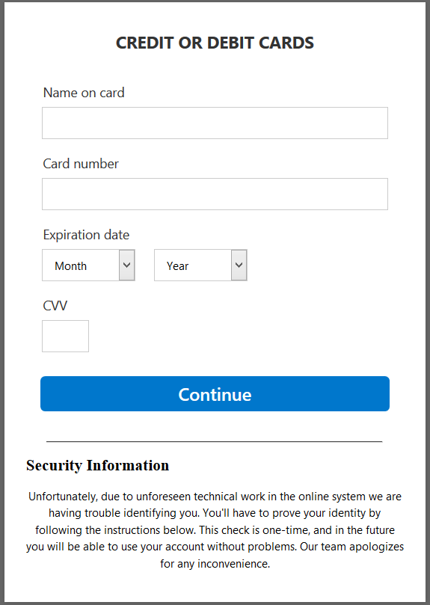
Thought you could click that?

Slide 10
Tip 1
Solve Your Patching Problem… Even if You Don’t Think You Have One.

Slide 11
80 percent of attacks use vulnerabilities for which patches already exist … … but poor patching practices are rampant.
Notes:
Jbird- see page 10 s&p footnote 10 for citation.

Slide 12
In a survey of 500 large publicly-traded U.S. companies, it’s clear that even top performers struggle with patching cadence. In fact, this group had over 100,000,000 issues in just 6 months.
Notes:
jbird please pull better quality graphic from s&p 500 report

Slide 13
Tip 2
Understand what makes up your entire risk surface.

Slide 14
Critical Data Point: IoT Landscape Posing Increased Risks
SecurityScorecard assessed over 200,000 IoT devices and found many that were vulnerable- i.e. in the case of healthcare organizations, hackers can get access to PHI.
Notes:
SecurityScorecard recently identified 205,390 IoT devices on the public internet (IPv4) which were currently vulnerable to remote exploitation via CVE-2017-7577-- a publicly known vulnerability that can allow hackers to look for, and eventually gain access to, sensitive files.

Slide 15
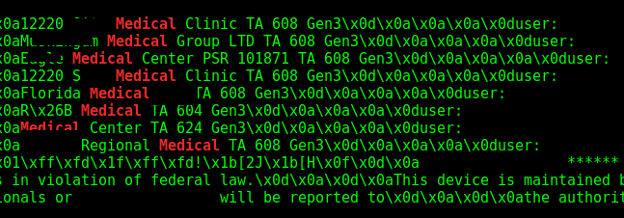
Not only is the healthcare industry making use of legacy routers exposed to public internet, we see information about the hospital using these routers.
Notes:
The majority of the services on these ports are legacy systems, either antiquated routers that provide access to internal network resources (such as patient data and medical equipment), as well as FTP servers that are hosting patient data and records.
on Port 23/telnet (commonly used for enterprise routers and other IoT devices)

Slide 16
We’re able to see this publicly accessible FTP Server running on the hospital network→ this is probably where patient data is uploaded.
FTP = no encryption and often can be readily exploited.

Slide 17
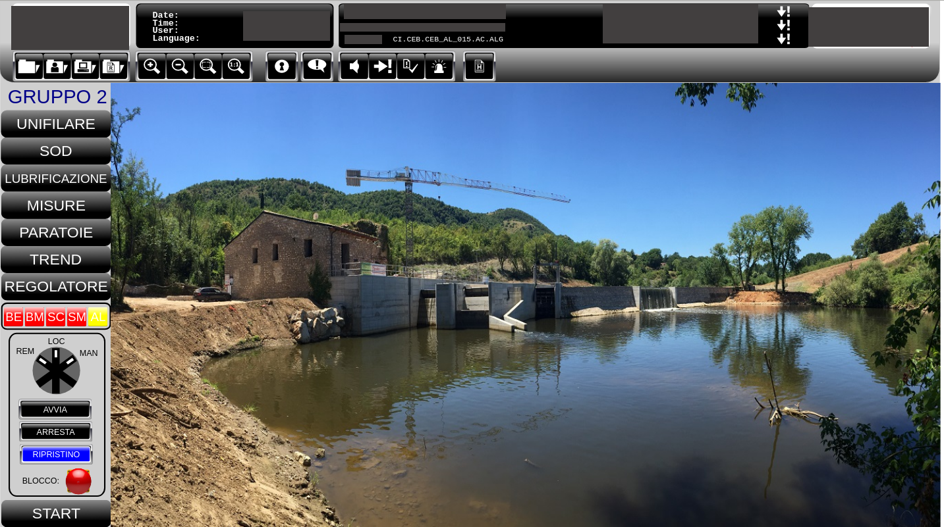
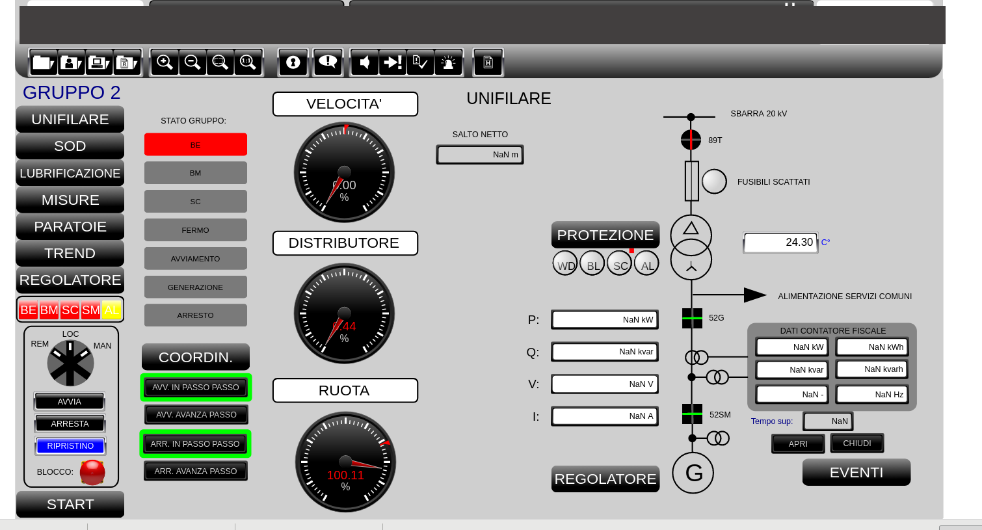
Exposed IoT devices which control critical infrastructure
Water dam control system with no authentication
Notes:
Hacking into …. A dam

Slide 18
Tip 3
Look for risk in the right places.

Slide 19
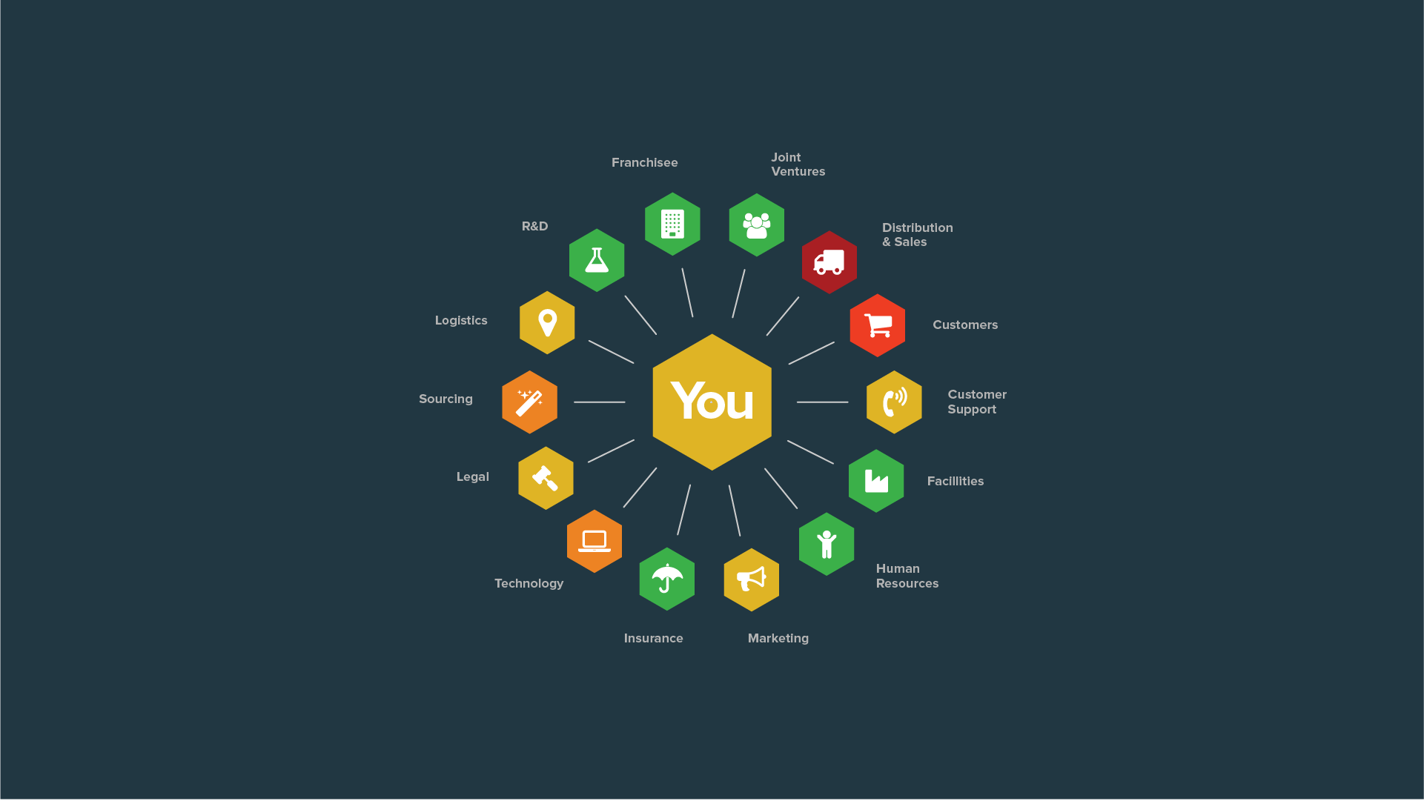
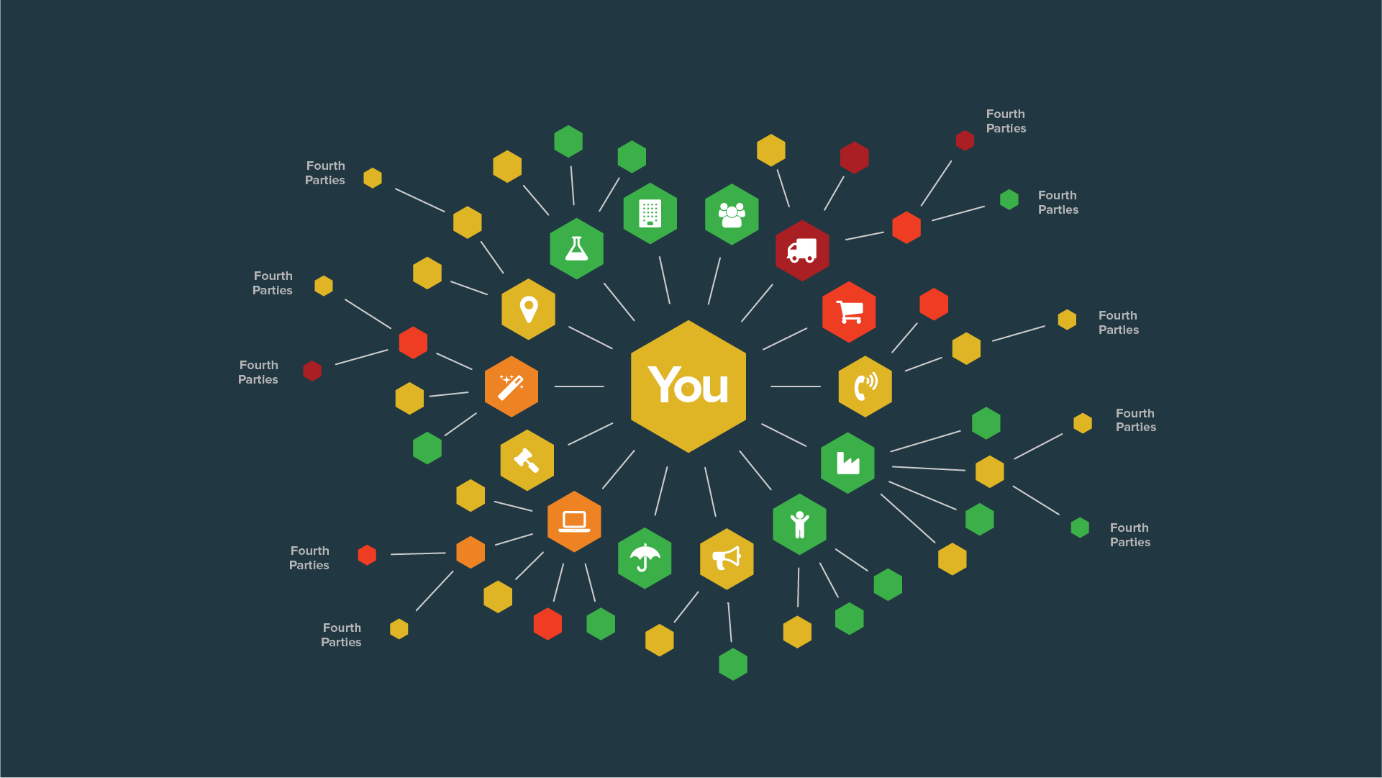
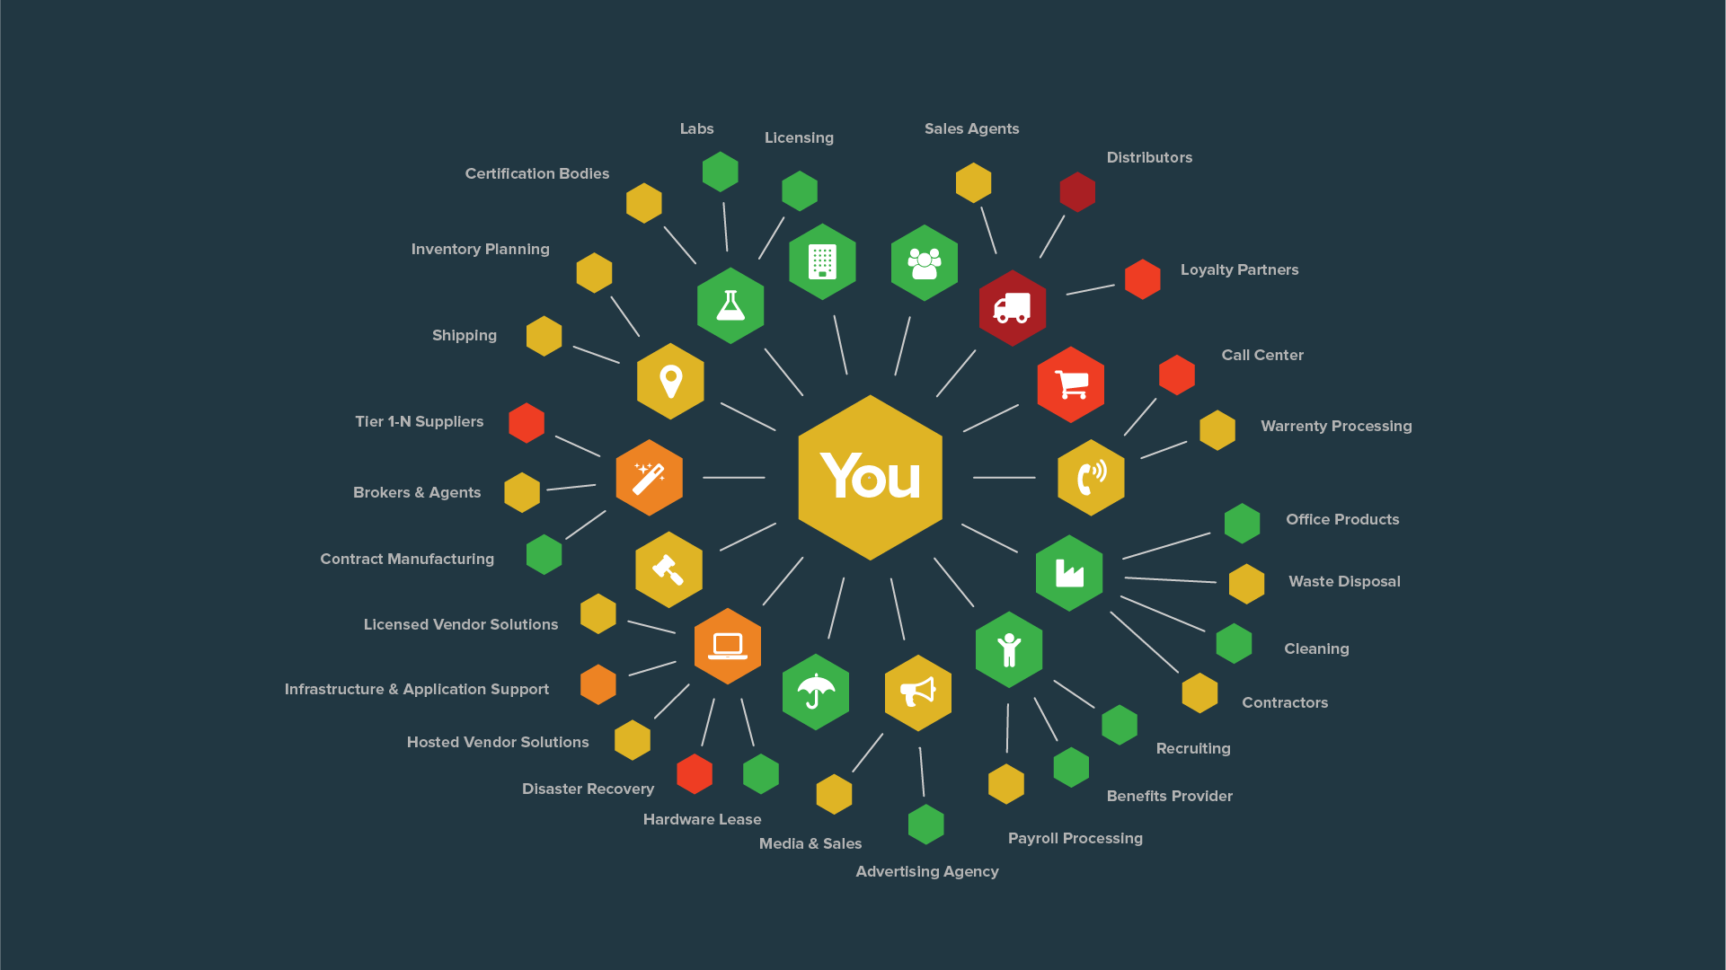
Over 70% of risks originating from the ecosystem (vendors, business partners, subsidiaries et al)
Notes:
To illustrate the problem, in the “not so old” days, your organizations security was just that. How secure was your organization? You used firewalls and other network and application security tools to secure your perimeter to guard servers and endpoints from the exploitation of vulnerabilities. Your organization’s security NOW also depends on how secure your entire ecosystem is.
Most financial services companies now have a complex and huge supplier/partner eco-system. There are third parties, fourth parties, lots of different vendors supplying many different products and services.
And the “current state” for most FinServ companies is broken. Most enterprise third-party security programs still rely on manual, point-in-time, largely subjective assessments to evaluate and manage the security risk of their third parties. The process using Tools like questionnaires, pen tests, site visits, etc., really has not adapted well to this new world where confidential data is everywhere, vendors and partners have trusted access, and risk is decentralized. At best programs using these traditional tools can only scale to assess 15-20% of the third party eco-system, usually just the highest risk vendors. This leaves large areas of un-managed security risk resulting in:
No visibility at all into security programs at 80-90% of the vendor eco-system. Is there a Target HVAC vendor out there somewhere?
No continuous monitoring and pro-active collaboration with the High Risk vendors. What happens is security goes sideways in one of your high risk vendors between annual assessments and you don’t know about it?
Compliance Risk: Regulators are shining a bright light on third party programs – how do you prove you are doing enough?

Slide 20
Third party risk challenges
Third parties are proliferating, more critical to the business
Risk events worsen, impact growing more severe
Long and resource-intense assessment process
Inconsistent data & incomplete responses from 3rd parties
External factors influence risk posture (e.g., geopolitics)
Source: Forrester Webinar Dec 2017
Notes:
Redesign and attribute to Forrester

Slide 21
Tip 4
An once you’re looking in the right place… make sure you’re asking the right questions.

Slide 22
What Framework? What Questionnaire? What Standard? What Report? What Risk Areas? How?

Slide 23
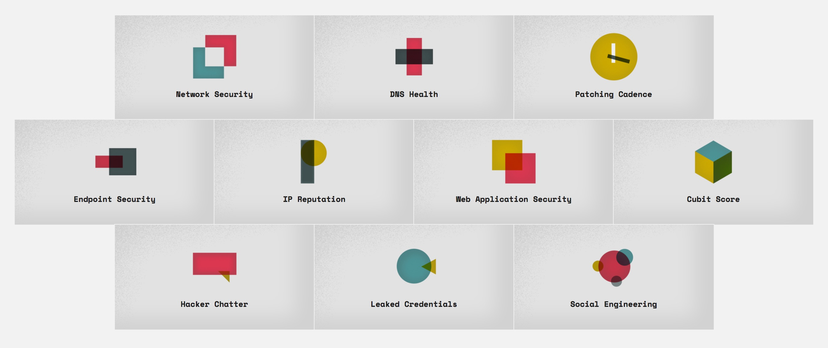
10 Risk Factors

Slide 24
Tip 5
And make sure everyone is speaking the same language.

Slide 25
CISOs are from Mars, Board members are from Venus
I’ve deployed Akamai Prolexic for SYN FLOOD mitigation on our 72.2.52.1/24 production network.
Oh.. You mean you spent $300K on a product that will prevent a $2M revenue loss from website disruption?

Slide 26
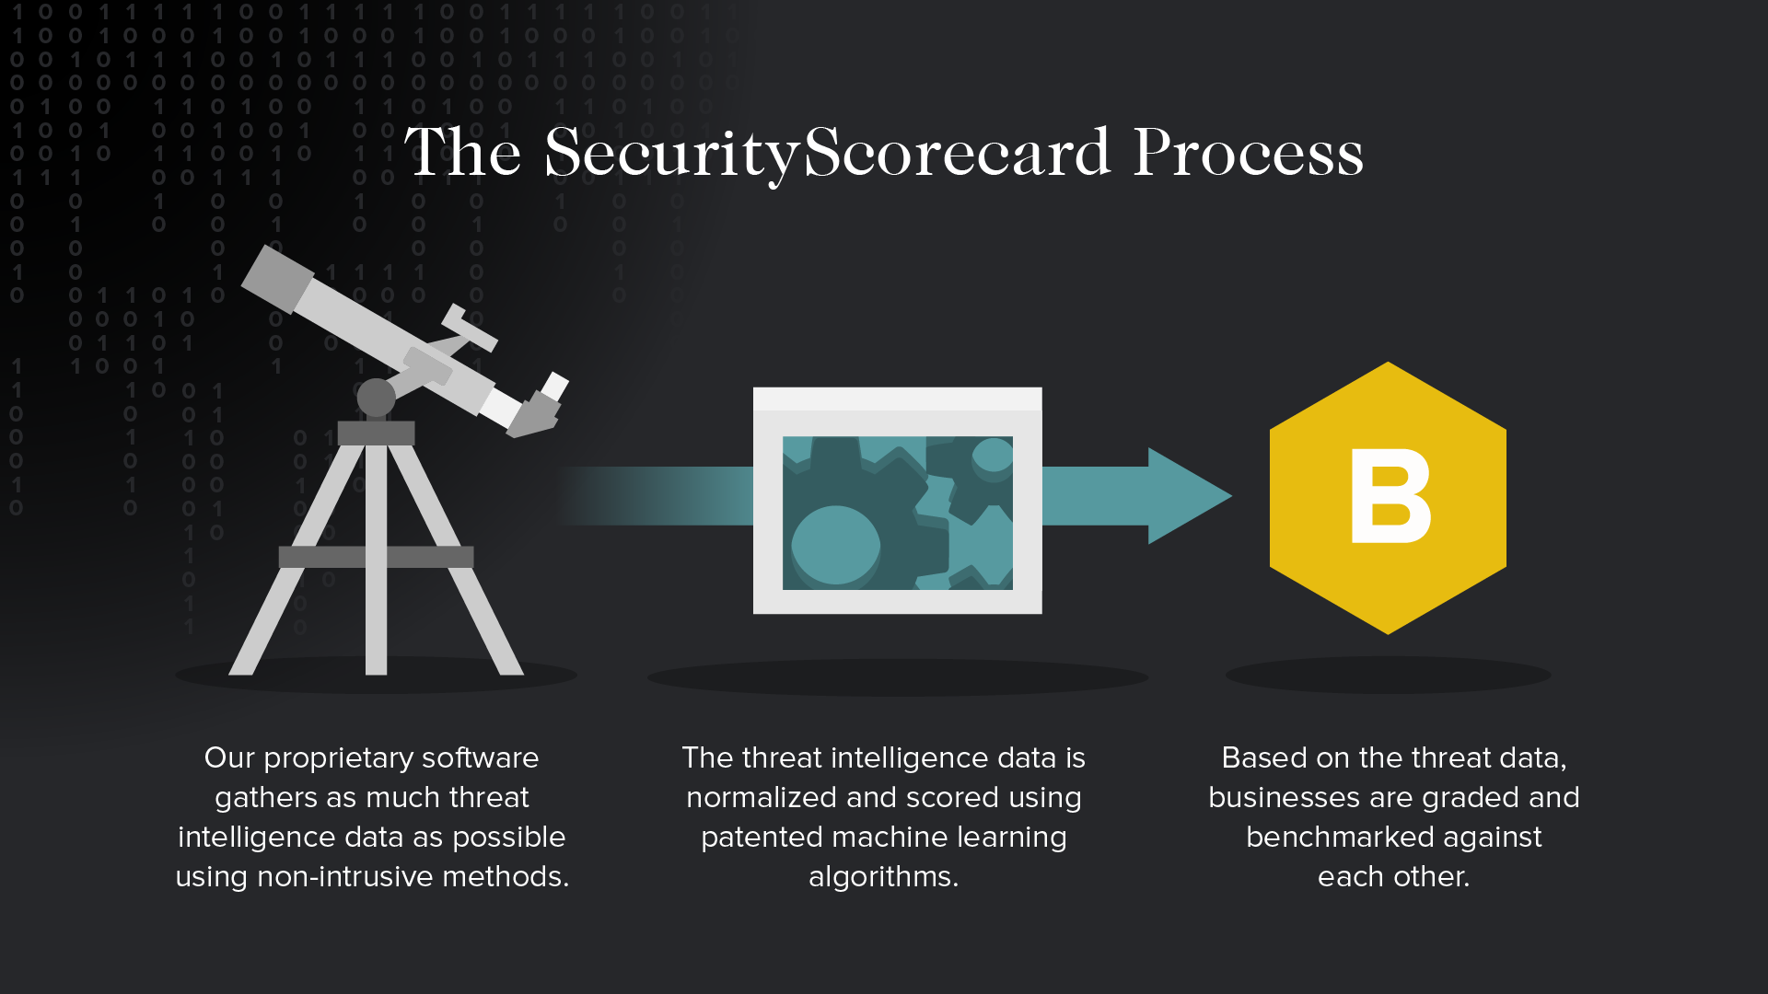
Tip 7
And then find a way to make it all manageable and easy to talk about.

Slide 27
Notes:
Diving a layer deeper, let me walk you through our proprietary technology stack. We have invested 3+ years and millions of dollars into developing our own data collection and processing platform, which is one of our biggest differentiators in the space. We hold 5 US patents on this technology with several more filed.
Working from the bottom up:
Data Collection: Starting at the Data Collection later, we have built a proprietary collection of sensors and software which continuously observe millions of security signals every day across the entire IPV4 space, ie the entire internet. Our R&D team continuously innovates on the techniques and this allows us to collect the deepest and broadest set of interesting security signals in the marketplace.
Threatmarket: Next step is we process and “curate” this data in an internal big data platform that we call ThreatMarket. We normalize the data, remove noise from signal, and organize it in relevant security silos. The system also does global IP Attribution, which allows the platform to calculate which internet facing IP addresses belong to which companies.
Factor Grades & Overall Grade: Since our data platform now has a huge library of continuously updated threat signals, organized in 10 factors and attributed to over 100k different companies, we then apply a scoring algorithm to each company which gives an Overall A-F letter grade, and individual factor grades, which is a benchmark score comparing the relative security risk of a given company to its peer group of similarly sized companies in the same industry.
The SaaS platform displays all the company scorecards, and organizes the data for effective monitoring, reporting and management of third party security.

Slide 28
Notes:
The SecurityScorecard rating platform allows you to:
SHOW DUE CARE WITH THE REGULATORS, KEEP THEM OUT OF YOUR OFFICE
REDUCE THIRD PARTY BREACH RISK, KEEP YOUR COMPANY OUT OF THE NEWS
SCALE YOUR THIRD PARTY SECURITY PROGRAM WITHOUT ADDING RESOURCES
For existing vendors, the rating is used for:
Visualizing and quantifying where your risk is across large numbers of vendors
Prioritizing vendors for the SSC remediation workflow to close open security issues and reduce risk
C level and board reporting on progress to reduce third party risk
For new vendors the rating is used for:
Initial security assessments in the RFP stage without full questionnaire process
Faster contracting/onboarding process. Ex) for medium and low risk vendors, fast track the contractual security process if A or B.., reduce the number of new vendors that consume security resources

Slide 29
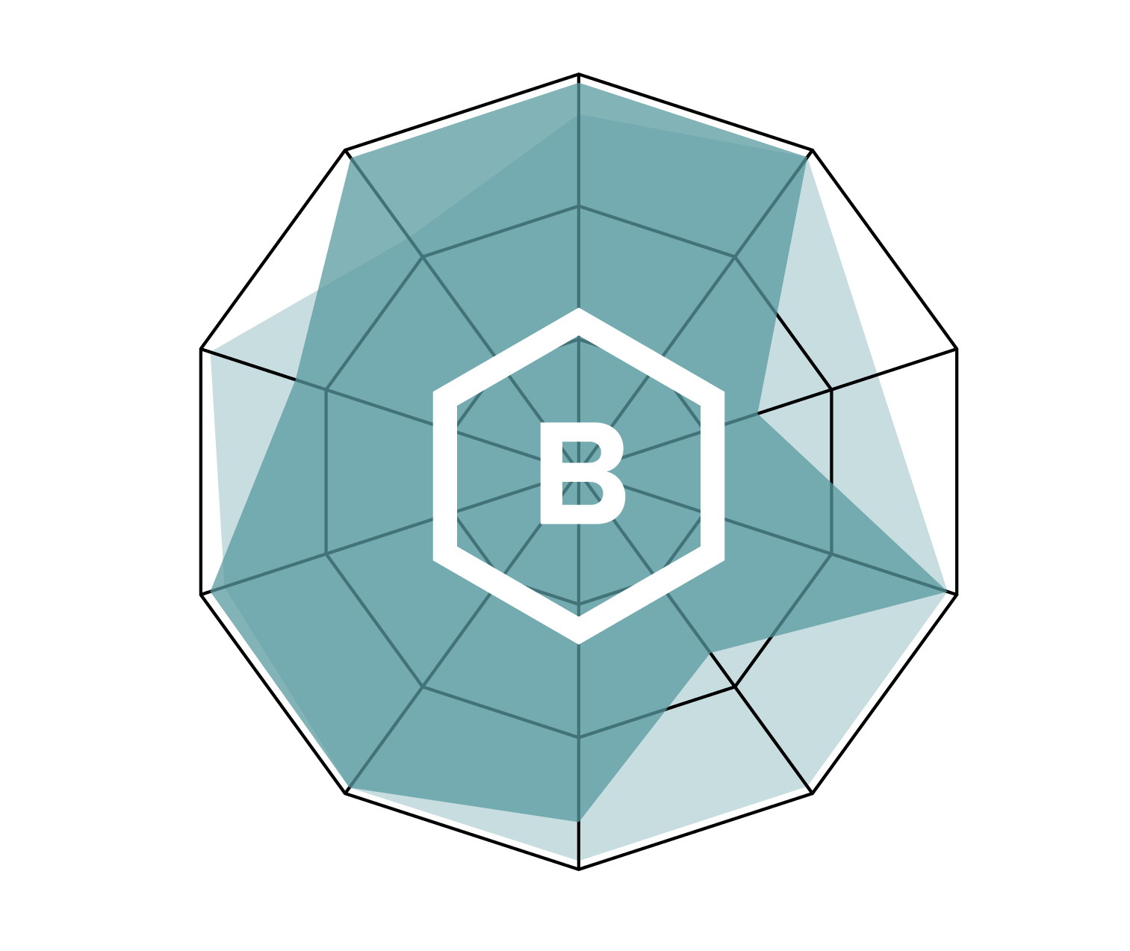
Crystal-clear, comprehensive reporting.
Notes:
(I agree – maybe we kill this slide )Not clear on how this slide says anything at all about our reporting and how it’s clear and comprehensive?

Slide 30
Recap
Solve Your Patching Problem… Even if You Don’t Think You Have One.
Understand what makes up your entire risk surface.
Look for risk in the right places.
An once you’re looking in the right place… make sure you’re asking the right questions.
And make sure everyone is speaking the same language.

Slide 31
Contact Us
www.securityscorecard.com
800 682-1707
sales@securityscorecard.com
214 West 29th St, 5th Floor
New York, NY 10001

